Slide 1
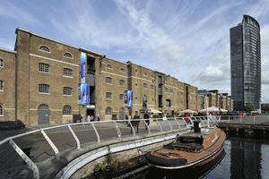
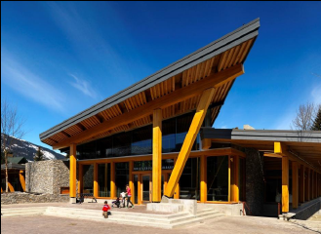
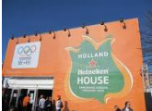
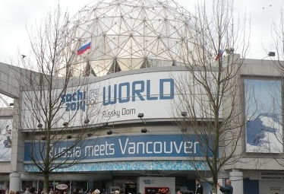
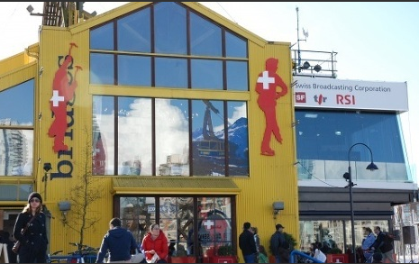


New Perspectives on the Olympic Movement: A Comparative Investigation of National Olympic Hospitality Houses
Dr. Richard Baka,
College of Sport and Exercise Science Insitute for Sport Exercise & Active Living
Victoria University

Slide 2
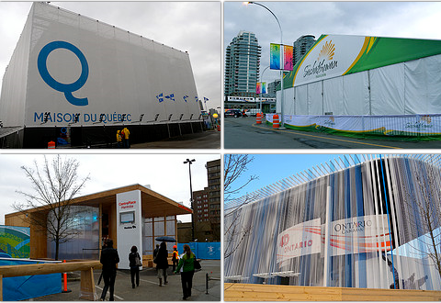
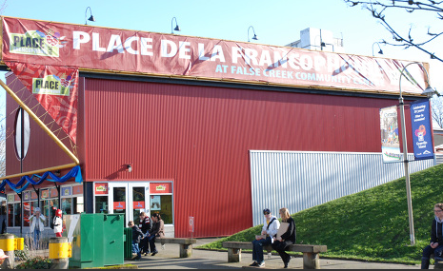
Introduction
Organised by National Olympic Committees
Used by NOC officials, athletes, families/friends & guests
Meeting point for media and business partners/sponsors
Venues for governments to showcase themselves
Different levels of access (by invitation only and/or public access)
Focus on Germany, Canada, Holland, USA and Australia in this study

Slide 3
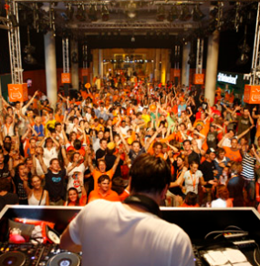
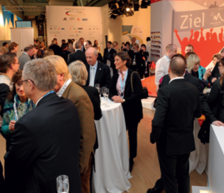
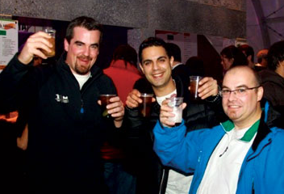
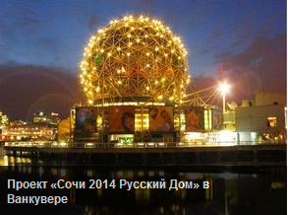
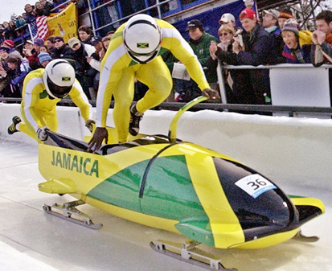
Hospitality Houses of Vancouver 2010
Canada Olympic Houses (2x)
Irish House
Dutch House
USA House
Switzerland House (2x)
Jamaica Bobsleigh House
Austria House
Russian House
Norway House
Slovenia House
German House (2x)
France House
Italian House

Slide 4

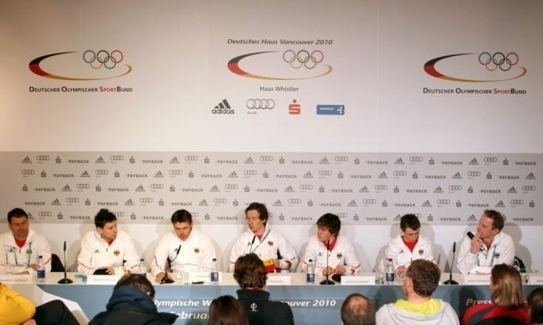
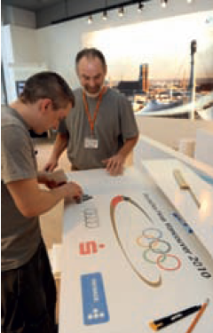
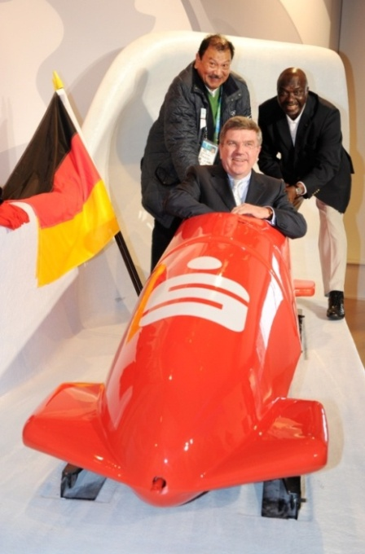
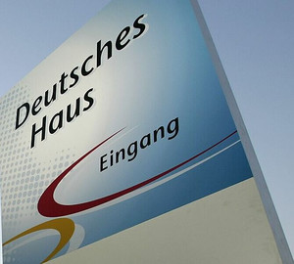
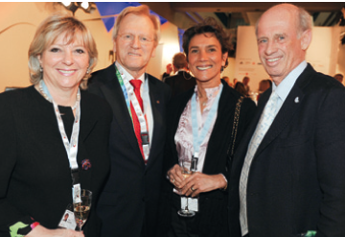
German Olympic House (GOH): History and Development
First one during the 1988 Calgary Olympic Winter Games
Aim: “Embassy of German Sport”, developed from a small meeting point to a professional communication platform
Includes TV broadcasts, press conferences, athlete receptions, corporate hospitality, NOC visitor hosting, etc.
Only on during the Games period, in Beijing could accommodate 900 guests/day, Vancouver 560 guests per day

Slide 5
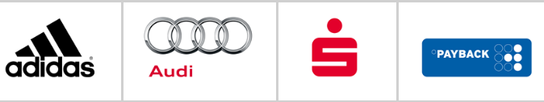

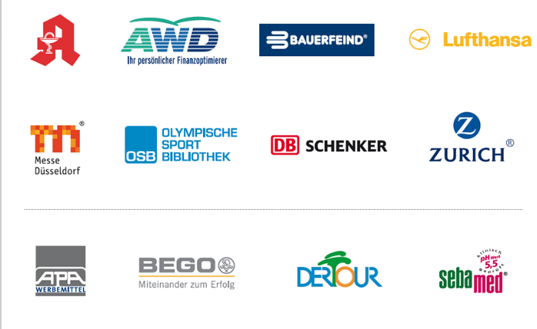

Concept
Main organizer is the DSM (official marketer of the German NOC)
Düsseldorf Trade Fair is also a key player
Financed by official sponsors & cooperation partners
In return options for meetings & corporate hospitality

Slide 6
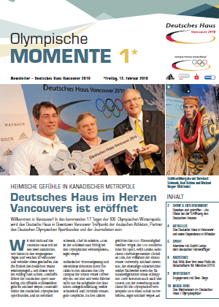
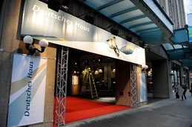
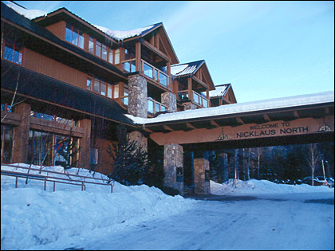
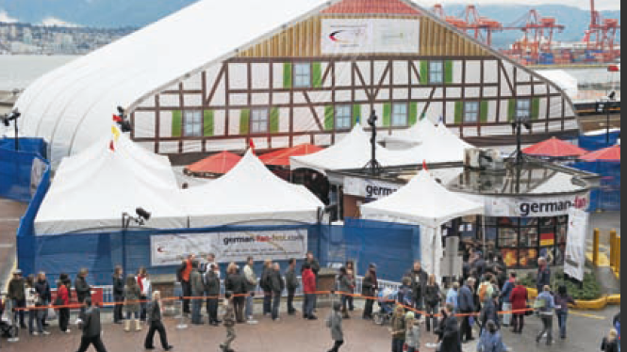
German Olympic House: Vancouver 2010
Had two houses: main one in Vancouver at Simon Fraser University second base in Whistler
Operated from 12th to 27th February 2010
115 Staff members, 77 volunteers
Own daily published newspaper
German Fan Fest

Slide 7
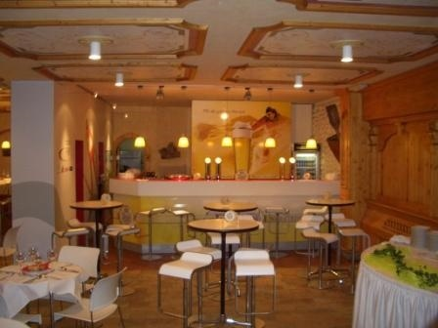
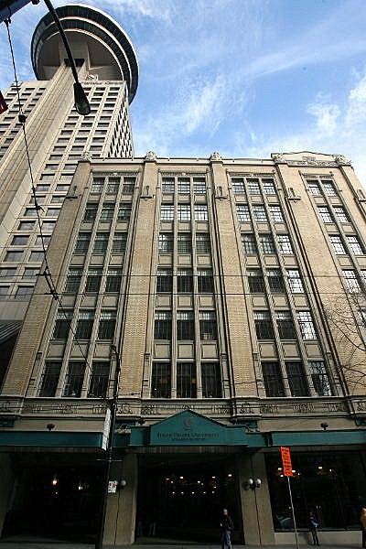
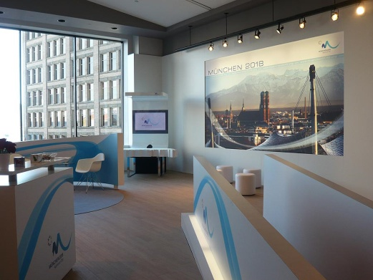
German Olympic House: Vancouver 2010
Simon Fraser University
Located in the centre of the Olympics
Capacity of 400-450 guests (1000 square meters)

Slide 8

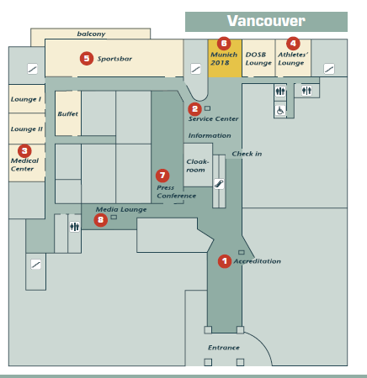

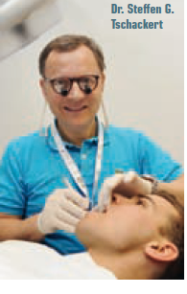
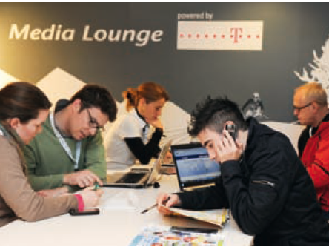

GOH Facilities in Vancouver

Slide 9
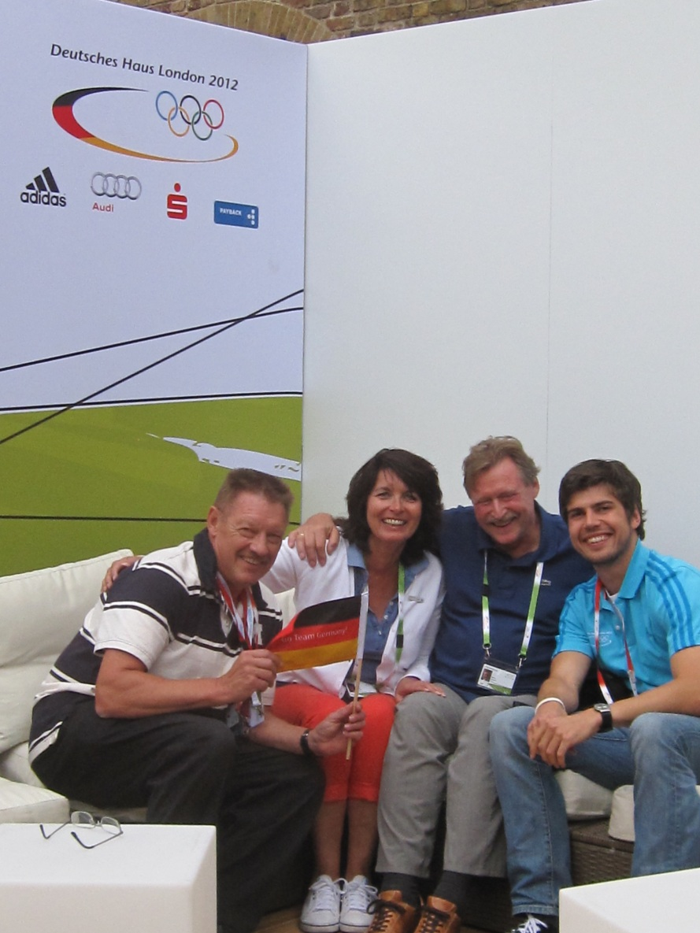
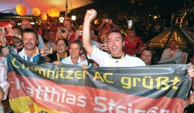
GOH: London 2012

Slide 10

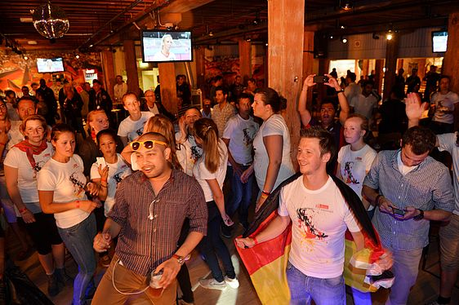
German Fan Fest London

Slide 11
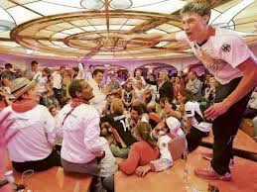
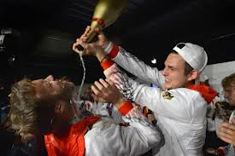
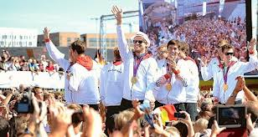
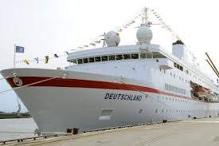
German Olympic House: Dream Ship

Slide 12
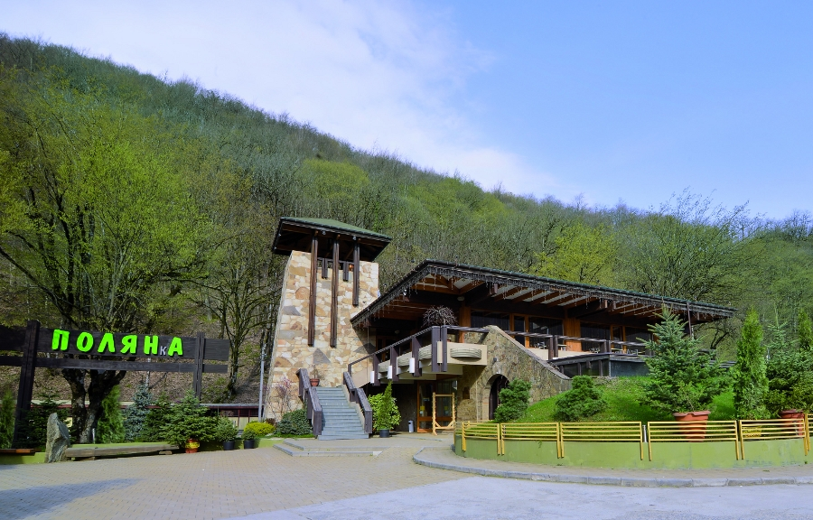
GOH: Sochi
Australia needs to reassess and posssibly consider a partnership with sponsors, government and the AOC (vast majority of athletes and officials like the idea).
Feedback for programs is generally excellent from athletes, families, friends, guests, sponsors, sport federations. etc.
Opportunities for student work integrated learning and valuable major sport event experience.
Concept of Olympic Houses is here to stay as Embassies of Sport have proven to be very popular (e.g. Heineken House). IOC has shown interest in the concept but is not inerested in control – moreso as a popular sideshow to the Games.
Sochi is proving difficult for many NOHHS due to costs, limited infrastructure in a small city; Rio should pose less problems.
Notes:
12

Slide 13
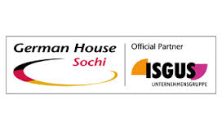
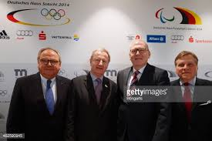
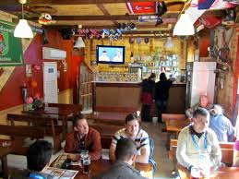
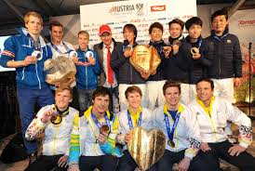
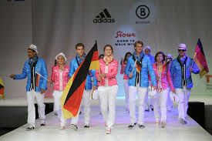
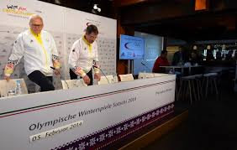

Slide 14
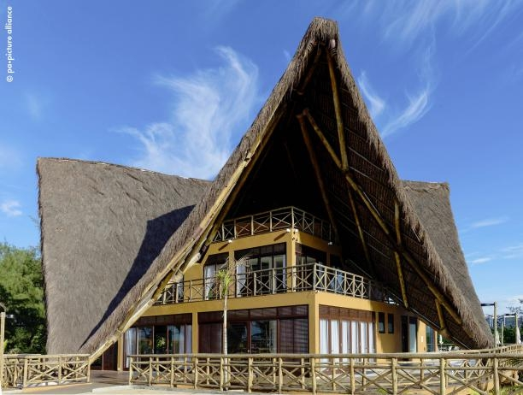
GOH Rio

Slide 15
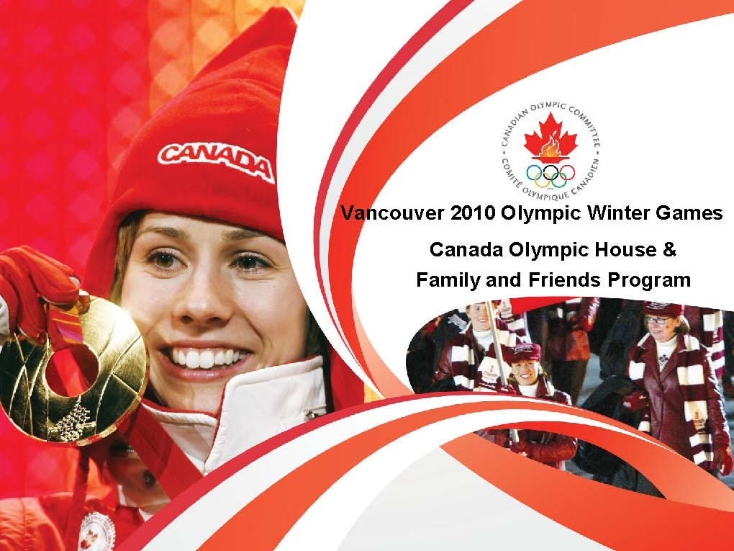

Slide 16

Canada Olympic House

Slide 17
Canada Olympic House
Meeting place for atheltes, their families, coaches, support staff, mission team members, sponsors and special guests
Distraction Management for Athletes who want to focus on performance (place to meet family, friendly environment, etc.)
Integral component of COC‘s Family and Friends Program
Aim :To make families and friends feel part of the Canadian Olympic Team and ecourage them to participate in the Olympic Games

Slide 18
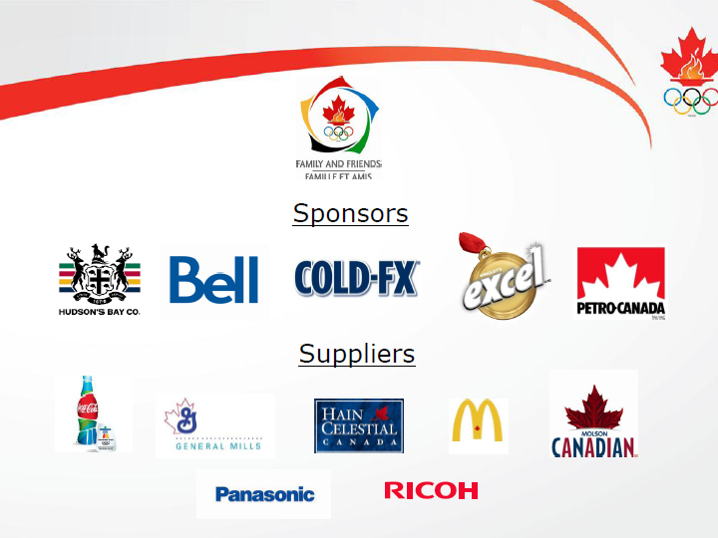
Canada Olympic House

Slide 19
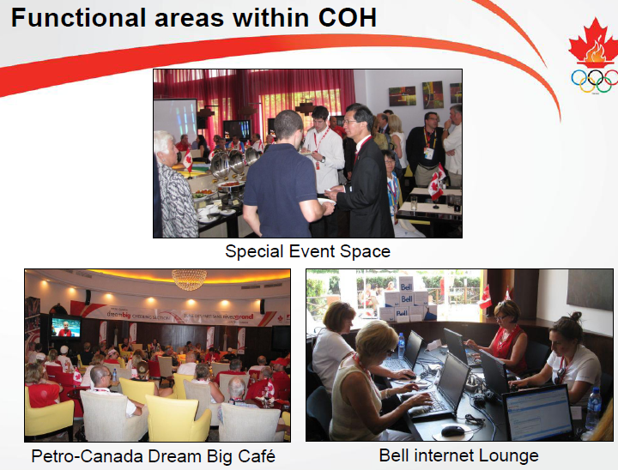
Canada Olympic House

Slide 20
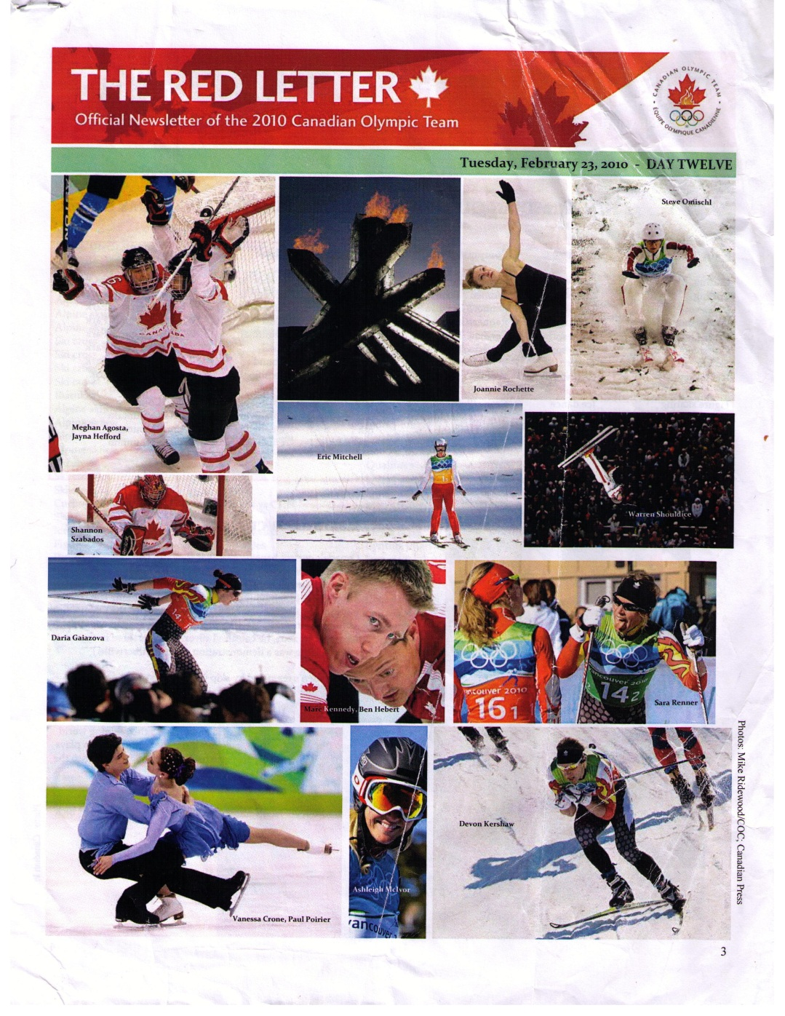
COH: Special Features

Slide 21
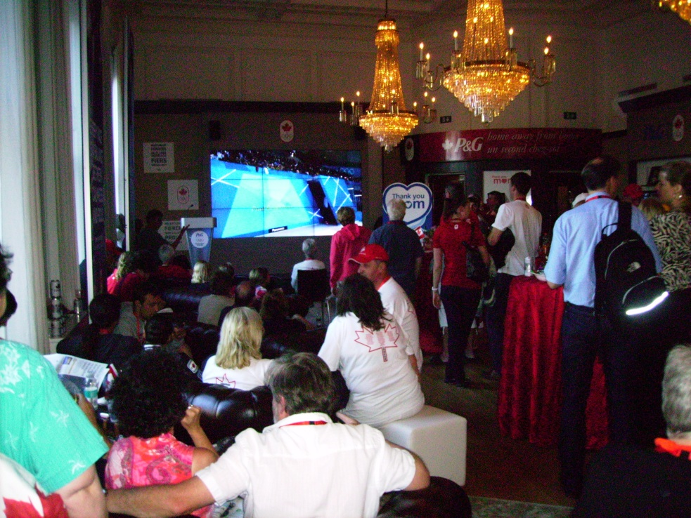
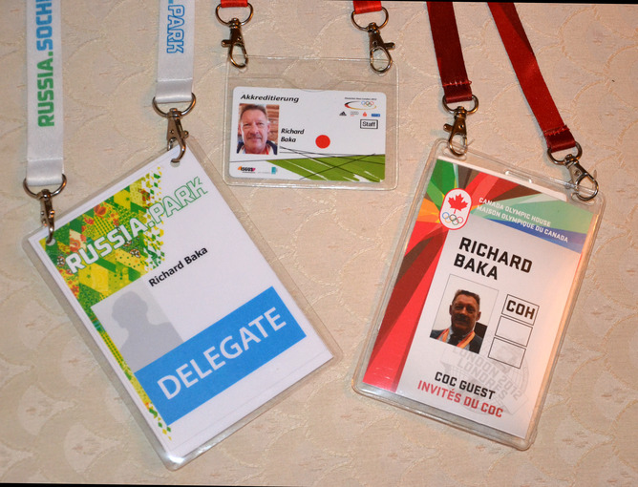

COH: London 2012

Slide 22



Slide 23








COH - Sochi

Slide 24


COH Rio
Plans for a COH but will not officially release details till early 2016 and will then confirm site, facilities and services; have had more board discussion re this than previously
Rio is the first time where the COC jointly designed the look, feel and function of COH with Marketing Partners’ objectives and activation desires in mind – which our Partners involved have appreciated.

Slide 25


Australia House
No AOC widespread support of an Olympic House
An unofficial event in LA in 1984 with functions at the Consul General’s house

Slide 26

Australia House
Tried the concept in Atlanta in1996 as a private model with corporate hospitality (Fosters sponsorship) and to especially promote the 2000 Sydney Games
AOC (i.e. President John Coates) felt it got a bit too “boozy” and it was not repeated
At each Games the AOC has an Athlete’s Reception, Government and sponsor functions and a victory tour post each Summer Games to major Australian cities

Slide 27



Australia House in London 2012
A commercial Aussie/Kiwi bar was set up but with no affiliation with AOC
Swimmers support group called POOS
Support for it by athletes and officials

Slide 28




NOHHS and Other Houses

Slide 29



Russia / Sochi Park in London

Slide 30



Heineken House: London

Slide 31




Heineken House

Slide 32





Heineken House - Sochi

Slide 33


Heineken House Rio
Located in Clube Monte Libano complex with 9000m2 serving 4000 guests/day

Slide 34




USA House / P&G Family House London

Slide 35



USA House Rio and New US Welcome Pavilion Where the World Discovers America

Slide 36

Feedback
“There are many facts why I like the German House. On the one hand I love the typical German food offered there. On the other hand it is quite nice to have an alternative to the mainstream activities during the games.”
(André Lange, Bobsleigh, Vancouver 2010)

Slide 37

Feedback
“The athletes are ready for the Olympics, but the parents are not always ready!”
(Christiane Despatie, Mother of Olympic gold & silver medallist)

Slide 38






Feedback
Familiar Atmosphere
Good communication platform
High satisfaction level (guests and business partners)
Notes:
Familiar Atmosphere
Good communication platform
High satisfaction level (guests and business

Slide 39


Comparative Features of NOHHS
Nation/House | History | Financing | Model | Access | Athletes | Partners | Media | Public
Germany | 1988 | NOC and sponsors | Hybrid private and public | Accreditation and public via an entry fee | x | x | x | x
Canada | 2002 | COC and sponsors | Private | Accreditation | x | x | x
Australia | 1996 (once) | Sponsors and SOCOG | N/A | N/A
Holland | 1992 | Heineken and others | Hybrid private and public | Accreditation and public via an entry fee | x | x | x | x
USA | 2002 | USOC and sponsors like P & G | Private | Accreditation | x | x

Slide 40
Conclusions
Relatively new concept for larger developed NOCs but more trying it with record numbers (40+) in London; Germany has longest history (1988) and Heineken House (1992) – most famous house.
Three models: (A) Private (by invite only e.g. COH) (B) Hybrid mostly corporate driven with private and public venues e.g. Heineken House (C) Hybrid with government and/or corporate support and used to promote future Games (e.g. Russia/Sochi House); the model of a NOHH can evolve and change over a period of time (e.g. USA in Rio).
Germany has evolved into a well developed model; its Fan Fest venue has proven to be a success; unique use of the cruise ship had its plusses and minuses.

Slide 41
Conclusions
4. Canada‘s Family and Friends program is excellent and having a Canadian Paralympic House is a positive step (other nations also did this); may need to consider adding a public venue due to some bad press in London by unhappy Canadian citizens.
Very little research on Olympic Houses (most data is from websites, interviews, and Participant Oberservation; keen interest by a few researchers including a team from Canada (Oreilly, Abeza and Seguin), USA (Burton) and Australia (Baka) (refer to chapter in new On the Periphery book).
The AOC should perhaps reassess and posssibly consider a partnership with sponsors, government and the AOC (vast majority of athletes and officials like the idea). Very disinterested response from the AOC when contacted in 2014.
Notes:
41

Slide 42


Slide 43


Slide 44
Conclusions
Feedback for programs is generally excellent from athletes, families, friends, guests, sponsors, sport federations, etc.
Opportunities for student work integrated learning and valuable major sport event experience.
9. Concept of Olympic Houses is here to stay as Embassies of Sport have proven to be very popular (e.g. Heineken House). IOC has shown interest in the concept but is not inerested in control – moreso as a popular sideshow to the Games.
10. Sochi proved difficult for many NOHHS due to costs, limited infrastructure in a small city – only 15 NOHHs most in the coastal cluster; Rio should pose less problems. Escalating costs may hamper future NOHHs.
Notes:
44

Slide 45


THE END

Slide 46
Sources
Interviews with volunteers and COC Staff and NOC Board Members
http://www.dsm-olympia.de
http://www.houseofswitzerland.org
http://www.olympic.ca
http://www.teamusa.org
http://www.irishhouse2010.com
http://www.vanmag.com/Entertainment/Best_Olympic_Houses
http://www.miss604.com/2010/01/vancouver-2010-pavilions-hospitality-houses.html
http://www.eventmagazine.co.uk/news/1121611/Exclusive-Two-Olympic- houses-confirm
http://www.citycaucus.com/2010venues/heineken-house

